Slide 1
Communications Merit Badge
Troop 344/9344
Pemberville, OH

Slide 2
Communications Merit Badge Requirements
Do ONE of the following:
For one day, keep a log in which you describe your communication activities. Keep track of the time and different ways you spend communicating, such as talking person-to-person, listening to teachers, the radio, or podcasts, watching television, using social media, reading books and other print media, and using any electronic communication device. Discuss with your counselor what your log reveals about the importance of communication in your life. Think of ways to improve your communications skills.
For three days, keep a journal of your listening experiences. Identify one example of each of the following, and discuss with your counselor when you have listened to:
Obtain information
Be persuaded
Appreciate or enjoy something
Understand someone's feelings
In a small-group setting, meet with other scouts or with friends. Have them share personal stories about significant events in their lives that affected them in some way. Take note of how each scout participates in the group discussion and how effectively each scout communicates their story. Report what you have learned to your counselor about the differences you observed in effective communication.
List as many ways as you can think of to communicate with others (face-to-face, by telephone, letter, e-mail, text messages, social media, and so on). For each type of communication discuss with your counselor an instance when that method might not be appropriate or effective.

Slide 3
Communications Merit Badge Requirements
Do ONE of the following:
Think of a creative way to describe yourself, using, for example, a collage, short story or autobiography, drawing or series of photographs, or a song or skit. Using the aid you created, make a presentation to your counselor about yourself.
Choose a concept, product, or service in which you have great confidence. Build a sales plan based on its good points. Try to persuade the counselor to agree with, use, or buy your concept, product or service. After your sales talk, discuss with your counselor how persuasive you were.
Write a five-minute speech. Give it at a meeting of a group.
Interview someone you know fairly well, like, or respect because of his or her position, talent, career or life experiences. Listen actively to learn as much as you can about the person. Then prepare and deliver to your counselor an introduction of the person as though this person were to be a guest speaker, and include reasons why the audience would want to hear this person speak. Show how you would call to invite this person to speak.

Slide 4
Communications Merit Badge Requirements
Attend a public meeting (city council, school board, debate) approved by your counselor where several points of view are given on a single issue. Practice active listening skills and take careful notes of each point of view. Prepare an objective report that includes all points of view that were expressed, and share this with your counselor.
With your counselor's approval, develop a plan to teach a skill or inform someone about something. Prepare teaching aids for your plan. Carry out your plan. With your counselor, determine whether the person has learned what you intended.
Do ONE of the following:
Write to the editor of a magazine or your local newspaper to express your opinion or share information on any subject you choose. Send your message by fax, email or regular mail.
Create a web page or blog of special interest to you (for instance, your troop or crew, a hobby, or a sport). Include at least three articles or entries and one photograph or illustration, and one link to some other web page or blog that would be helpful to someone who visits the web page or blog you have created. It is not necessary to post your web page or blog to the internet, but if you decide to do so, you must first share it with your parents and counselor and get their permission.
Use desktop publishing to produce a newsletter, brochure, flier or other printed material for your scout troop, class at school, or other group. Include at least one article and one photograph or illustration.

Slide 5
Communications Merit Badge Requirements
Plan a troop or crew court of honor, campfire program, or interfaith worship service. Have the patrol leaders' council approve it, then write the script and prepare the program. Serve as master of ceremonies.
Find out about three career opportunities in communication. Pick one and find out the education, training, and experience required for this profession. Discuss this with your counselor, and explain why this profession might interest you.

Slide 6
Requirement 1
Do ONE of the following:
For one day, keep a log in which you describe your communication activities. Keep track of the time and different ways you spend communicating, such as talking person-to-person, listening to teachers, the radio, or podcasts, watching television, using social media, reading books and other print media, and using any electronic communication device. Discuss with your counselor what your log reveals about the importance of communication in your life. Think of ways to improve your communications skills.
For three days, keep a journal of your listening experiences. Identify one example of each of the following, and discuss with your counselor when you have listened to:
Obtain information
Be persuaded
Appreciate or enjoy something
Understand someone's feelings
In a small-group setting, meet with other scouts or with friends. Have them share personal stories about significant events in their lives that affected them in some way. Take note of how each scout participates in the group discussion and how effectively each scout communicates their story. Report what you have learned to your counselor about the differences you observed in effective communication.
List as many ways as you can think of to communicate with others (face-to-face, by telephone, letter, e-mail, text messages, social media, and so on). For each type of communication discuss with your counselor an instance when that method might not be appropriate or effective.

Slide 7
What is Communication?
Communication is the act of sharing information with others.
Every communication involves (at least) one sender, a message and a recipient.
The sender ‘encodes’ the message, usually in a mixture of words and non-verbal communication. It is transmitted in some way (for example, in speech or writing), and the recipient ‘decodes’ it.

Slide 8
Types of Communication

Slide 9
Effective Communication
Effective communication is the process of exchanging ideas, thoughts, opinions, knowledge, and data so that the message is received and understood with clarity and purpose.
When we communicate effectively, both the sender and receiver feel satisfied.

Slide 10
Effective Communication
Effective communication sounds like it should be instinctive, but all too often, when we try to communicate with others something goes astray.
We say one thing, the other person hears something else, and misunderstandings, frustration, and conflicts ensue.
This can cause problems in your home, school, and work relationships.

Slide 11
Effective Communication
For many of us, communicating more clearly and effectively requires learning some important skills.
Learning these skills can deepen your connections to others, build greater trust and respect, and improve teamwork, problem solving, and your overall social and emotional health.

Slide 12
How to improve your communication skills
Here are a few ways to start improving your communication skills:
Effective Communication Skill #1: Consider your audience.
Knowing your audience can be key to delivering the right messages effectively.
Their age, race, ethnicity, and gender can all impact how they’ll receive your message.
It helps you tailor your message to your audience and engage them, avoid miscommunication, and build relationships.

Slide 13
How to improve your communication skills
Effective Communication Skill #2: Practice active listening.
Active listening is the practice of giving your full attention in a communication exchange.
When communicating with others, we often focus on what we should say. However, effective communication is less about talking and more about listening.
Listening well means not just understanding the words or the information being communicated, but also understanding the emotions the speaker is trying to convey.

Slide 14
Tips for becoming an active listener
Focus fully on the speaker. You can't listen in an engaged way if you're constantly checking your phone or thinking about something else. You need to stay focused on the moment-to-moment experience in order to pick up the subtle nuances and important nonverbal cues in a conversation. If you find it hard to concentrate on some speakers, try repeating their words over in your head—it'll reinforce their message and help you stay focused.
Favor your right ear. As strange as it sounds, the left side of the brain contains the primary processing centers for both speech comprehension and emotions. Since the left side of the brain is connected to the right side of the body, favoring your right ear can help you better detect the emotional nuances of what someone is saying.
Avoid interrupting or trying to redirect the conversation to your concerns. By saying something like, “If you think that's bad, let me tell you what happened to me.” Listening is not the same as waiting for your turn to talk. You can't concentrate on what someone's saying if you're forming what you're going to say next. Often, the speaker can read your facial expressions and know that your mind's elsewhere.

Slide 15
Tips for becoming an active listener
Show your interest in what's being said. Nod occasionally, smile at the person, and make sure your posture is open and inviting. Encourage the speaker to continue with small verbal comments like “yes” or “uh huh.”
Try to set aside judgment. In order to communicate effectively with someone, you don't have to like them or agree with their ideas, values, or opinions. However, you do need to set aside your judgment and withhold blame and criticism in order to fully understand them. The most difficult communication, when successfully executed, can often lead to an unlikely connection with someone.
Provide feedback. If there seems to be a disconnect, reflect what has been said by paraphrasing. “What I'm hearing is,” or “Sounds like you are saying,” are great ways to reflect back. Don't simply repeat what the speaker has said verbatim, though—you'll sound insincere or unintelligent. Instead, express what the speaker's words mean to you. Ask questions to clarify certain points: “What do you mean when you say…” or “Is this what you mean?”

Slide 17
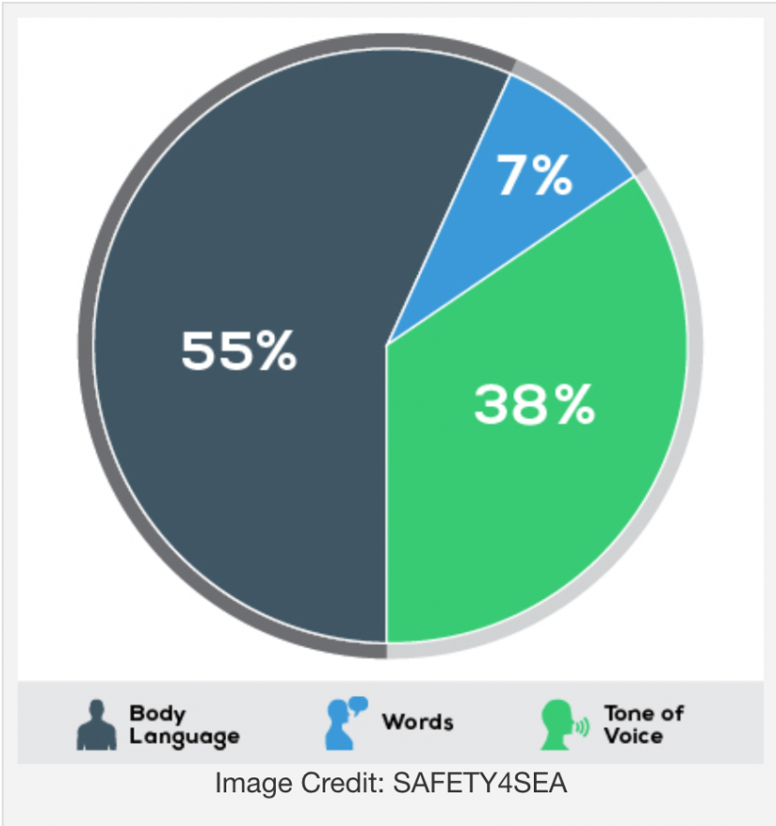
How to improve your communication skills
Effective Communication Skill #3: Pay attention to nonverbal signals
Nonverbal communication, or body language, includes facial expressions, body movement and gestures, eye contact, posture, the tone of your voice, and even your muscle tension and breathing.
In face-to-face conversation, body language plays an important role.
Up to 93 percent of communication does not involve what you are actually saying.
The way you look, listen, move, and react to another person tells them more about how you're feeling than words alone ever can.

Slide 18
How to improve your communication skills
You can enhance effective communication by using open body language
arms uncrossed
your posture is upright and receptive
your palms are open
you lean in when speaking or listening or sit on the edge of your seat
nod encouragingly.
maintain eye contact with the person you're talking to.
You can also use body language to emphasize or enhance your verbal message—patting a friend on the back while complimenting him on his success, for example, or pounding your fists to underline your message.

Slide 19
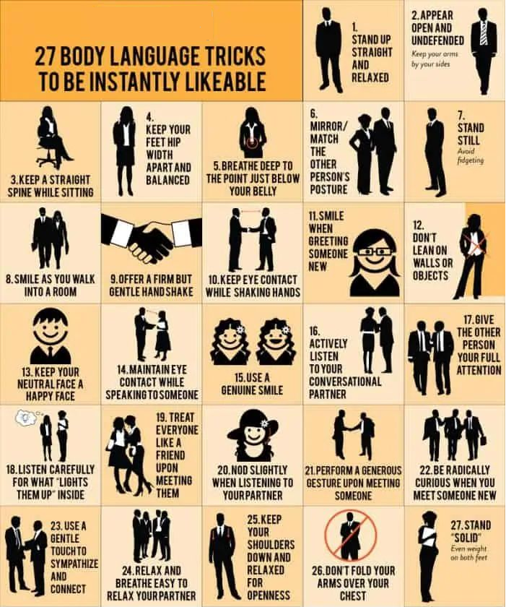

Slide 20
How to improve your communication skills
Use nonverbal signals that match up with your words rather than contradict them.
If you say one thing, but your body language says something else, your listener will feel confused or suspect that you're being dishonest.
For example, sitting with your arms crossed and shaking your head doesn't match words telling the other person that you agree with what they're saying.
Adjust your nonverbal signals according to the context. The tone of your voice, for example, should be different when you're addressing a child, your peers, or when you're addressing adults.

Slide 21
How to improve your communication skills
Avoid negative body language.
Negative body language can include:
biting your lip nervously
looking bored
crossing your arms
putting your hands on your hips
tapping your foot impatiently.

Slide 22
How to improve your communication skills
Take into account the cultural background of the person you're interacting with.
Body language can have different meanings in different countries that can lead to misunderstandings.
In some countries, nodding the head up and down means “no” while it means “yes” in the United States.
The peace sign or victory gesture may be polite in this country, but is considered rude or insulting in other countries.

Slide 23
Sharing Personal Stories
Share your personal story.
When listening to another scout’s personal story, take note of how each scout participates in the group discussion and how effectively each scout communicates their story.
Utilize the questions on the next slide to help identify the differences you observed in effective communication.

Slide 24
Assessing Communication Skills
In a small-group setting, meet with other scouts. Each will share personal stories about significant events in their lives that affected them in some way. Take note of how each scout participates in the group discussion and how effectively each scout communicates their story. To assess communication skills of all participants during a presentation, pay attention to:
Tone of voice: Are participants friendly, upbeat, and pleasant?
Posture: Do participants sit upright and with a respectful stance, or are they lounging casually in the chair?
Body language: What positive body language did you observe? What negative body language did you observe?
What active listening skills did you observe? Do the participants seem interested in the presentations? Were they attentive? Are they asking relevant questions?
Confidence: Do the presenters sound genuine and appear to be sure of themselves?
Defensiveness: Are presenters responding negatively to questions that others ask?

Slide 25
Requirement 2
Do ONE of the following:
Think of a creative way to describe yourself, using, for example, a collage, short story or autobiography, drawing or series of photographs, or a song or skit. Using the aid you created, make a presentation to your counselor about yourself.
Choose a concept, product, or service in which you have great confidence. Build a sales plan based on its good points. Try to persuade the counselor to agree with, use, or buy your concept, product or service. After your sales talk, discuss with your counselor how persuasive you were.

Slide 26
Write a short autobiography
Your autobiographies will be shared during the next meeting.
Writing a short autobiography, requires condensing your life story into a concise and engaging narrative.
Here's a guide to help you craft a compelling mini-autobiography:
Introduction: Begin with a brief introduction that includes your name, place of birth, and the date of birth, providing the reader with essential information.
Early Life: Summarize your early years, including significant details about your family, childhood, and formative experiences that influenced your values or interests.
Key Milestones: Highlight major life milestones such as education, career, and personal achievements. Mention notable events that have shaped your journey.
Passions and Hobbies: Share your interests, hobbies, and passions that define your personality and bring depth to your story.
Challenges and Triumphs: Briefly mention significant challenges or obstacles you've faced and how you overcame them. This shows resilience and growth.

Slide 27
Write a short autobiography
Guide to help you craft a compelling mini-autobiography (continued):
Personal Philosophy: Offer a glimpse of your values, beliefs, or personal philosophies that guide your decisions and actions.
Impact and Legacy: Conclude with a reflection on the impact you hope to make or the legacy you wish to leave in the future.
Edit and Revise: After drafting, review your mini-autobiography for clarity, conciseness, and coherence. Eliminate unnecessary details.
Engaging Language: Use engaging language and vivid descriptions to make your narrative more appealing and relatable. When possible, add pictures or diagrams.
Maintain Authenticity: Ensure your mini-autobiography remains authentic and true to your life story.
Audience Consideration: Tailor your mini-autobiography to the audience you intend to share it with, adapting the content as needed.

Slide 28
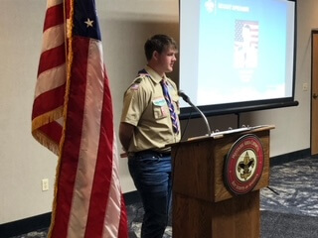
Requirement 3
Write a five-minute speech. Give it at a group meeting.

Slide 29
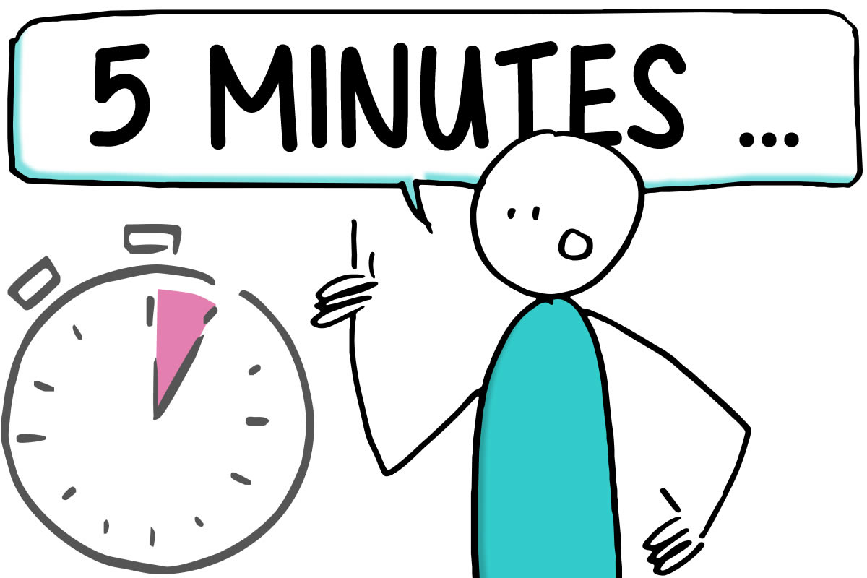
Writing a Speech
Preparing a 5-minute speech can seem daunting, but with a little bit of planning and practice, you can deliver a great speech. Here are some tips to get you started:
Choose a topic that you are passionate about and that your audience will find interesting. This will make it easier for you to engage with your audience and keep their attention.
Create an outline that includes an introduction, body, and conclusion. The introduction should grab the audience's attention, the body should provide supporting evidence for your main points, and the conclusion should summarize your main points and leave the audience with something to think about.
Remember to speak clearly and confidently, make eye contact with your audience, and use gestures and body language to enhance your message. Good luck with your speech!

Slide 30
Writing a Speech
For the opening of your speech, start with a hook that will grab your audience's attention, such as a surprising fact, short story, or a thought-provoking question. For the closing, end with a strong statement or call to action that will leave a lasting impression on your audience.
When you have finished a simple outline, write the main points and some additional minor points on numbered index cards. Do not write out your speech or try to memorize it word for word. That will result in a stiff-sounding presentation. You want your speech to flow naturally, as it would in conversation.
Practice your speech several times before delivering it. This will help you become more comfortable with the material and ensure that you stay within your time limit.
5-Minute Speech Outline Template
Use the provided template and sample outline to help you create your speech.

Slide 31
Requirement 4
Interview someone you know fairly well, like, or respect because of his or her position, talent, career or life experiences. Listen actively to learn as much as you can about the person. Then prepare and deliver to your counselor an introduction of the person as though this person were to be a guest speaker, and include reasons why the audience would want to hear this person speak. Show how you would call to invite this person to speak.

Slide 32
Interviewing a Guest Speaker
Requesting an interview:
Ask your parents permission to contact the person you would like to interview.
Call or email the person you would like to interview.
Introduce yourself and inform them that you are a Scout.
Ask politely if you could interview them as part of your Communication merit badge requirements.
Explain that the requirements include interviewing and preparing to introduce a guest speaker but that they are not being asked to be a guest speaker.
Ask if they are available to help you, and if so, when would be a good time to talk on the phone or meet so that you could ask some questions.
Inform them that you expect the interview to take no more than 10 or 15 minutes.
Provide contact information if necessary (phone number or email address)
If calling, have your questions along with a notebook and pen available in case they are available to help you at that time.

Slide 33
Interviewing a Guest Speaker
When interviewing a person, do not be afraid to politely ask the person to slow down or repeat a statement if you were not able to write down the information fast enough.
Questions to help prepare an introduction:
What is your full name and professional title?
How long have you been in your current position?
What are your duties?
What position did you have before this one?
What do you like best about your career?
What is the most difficult challenge you face in your position?
Did you go to college or receive special training?
What activities or interests do you enjoy when you are not working?
Is there anything else you would like to tell me about yourself?

Slide 34
Writing an Introduction for a Guest Speaker
Based on the person’s answers, write a short introduction of the speaker.
Stick to the most important and interesting facts.
You do not have to tell everything you learned.
Write a few key points on index cards that you can use as reminders.
Keep your introduction short.
Practice your introduction several times.

Slide 35
Writing an Introduction for a Guest Speaker
When giving your introduction, stand up, go to the front of the room, face the audience, and using your notecards give a brief introduction of the speaker.
An introduction example:
“Thank you for coming today to listen to our speaker. Our special guest speaker is Detective Kate Moore, a 10-year veteran with the Wood County Sheriff’s Office. Detective Moore has solved many puzzling crimes in our area. She has a bachelor’s degree in law enforcement from Bowling Green State University. When she is not working, she teaches karate and coaches softball. Detective Moore has graciously agreed to speak to us today about her position and other career opportunities in law enforcement. Please give a warm welcome to Detective Kate Moore.”

Slide 36
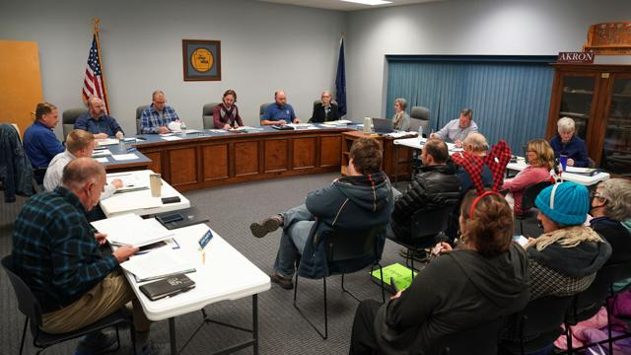
Requirement 5
Attend a public meeting (city council, school board, debate) approved by your counselor where several points of view are given on a single issue. Practice active listening skills and take careful notes of each point of view. Prepare an objective report that includes all points of view that were expressed, and share this with your counselor.

Slide 37
Public Meeting
Recording a Public Meeting Objectively
With your counselor’s and your parent’s approval, attend a public meeting.
You can find a list of public meetings in the local newspaper or on a local government website.
Take a notebook and a couple of pens or pencils to the meeting.
When you arrive, pick up a meeting agenda if one is available.
During the meeting, think of yourself as an observer and try not to judge or form an opinion about the topics of discussion or the people who are speaking.
Listen attentively and quietly and record what individuals say about the topics.
If an agenda item becomes a topic of debate, record what people on all sides of the issue said and what, if any, action was taken.
Stick to the facts and record all viewpoints.
Be sure to record the actions taken on each agenda item.

Slide 38
Public Meeting
Writing Your Report
As soon as you can after you get home, while the meeting is still fresh in your mind, write a report of the meeting.
Make the report as unbiased and factual as possible.
Do not state your own opinion in the report.
Focus most of your report on the topics that were debated or discussed.
Keep your report to one or two pages and summarize the main issues and points of view covered at the meeting.
Attach a copy of the agenda to your report if one was available.

Slide 39
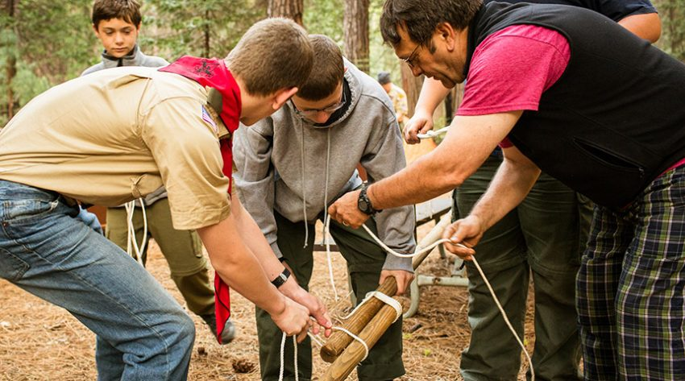
Requirement 6
With your counselor's approval, develop a plan to teach a skill or inform someone about something. Prepare teaching aids for your plan. Carry out your plan. With your counselor, determine whether the person has learned what you intended.

Slide 40
Teaching a Skill
The EDGE method is a four step method for teaching a skill:
Explain
First explain what you will be doing. Tell them the steps involved. Visual aids might be helpful for this step. Use questions to gauge their understanding.
Demonstrate
Show them how to do the skill. Demonstrate the steps using the actual materials. Describe what you are doing.
Guide
Let them practice the skill. Guide and coach them as they try to do it themselves. This step will take the most time.
Enable
Enable them by letting them do the skill themselves without any intervention.

Slide 41
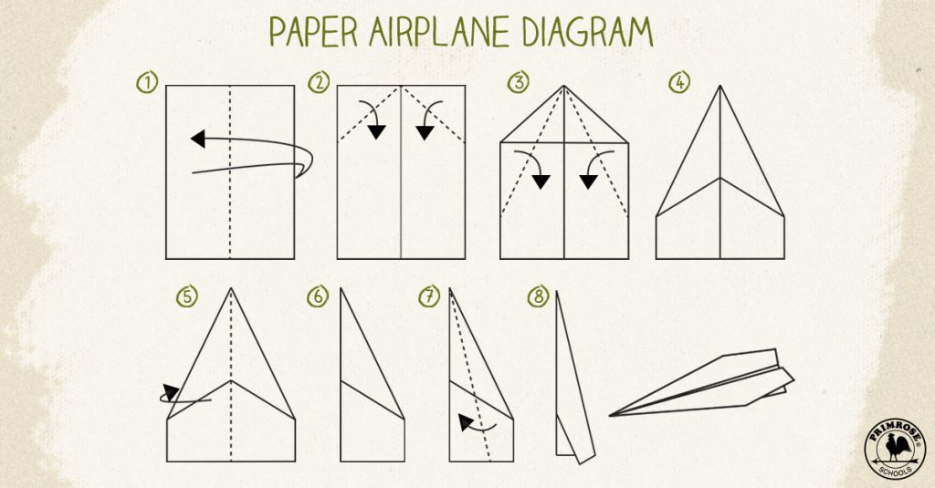
Teaching a Skill
Example of Teaching by the EDGE method:
How to make a paper airplane.
Explain: Verbally provide the instructions on how to make a paper airplane.
Demonstrate: Using a piece of paper, show how to make the paper airplane.
Guide: Give each participant a piece of paper and describe each step. As each step is described, the participants do it with their piece of paper.
Enable: Give each participant another piece of paper and have them make a paper airplane on their own.

Slide 42
Requirement 7
Do ONE of the following:
Write to the editor of a magazine or your local newspaper to express your opinion or share information on any subject you choose. Send your message by fax, email or regular mail.
Create a web page or blog of special interest to you (for instance, your troop or crew, a hobby, or a sport). Include at least three articles or entries and one photograph or illustration, and one link to some other web page or blog that would be helpful to someone who visits the web page or blog you have created. It is not necessary to post your web page or blog to the internet, but if you decide to do so, you must first share it with your parents and counselor and get their permission.
Use desktop publishing to produce a newsletter, brochure, flier or other printed material for your scout troop, class at school, or other group. Include at least one article and one photograph or illustration.

Slide 43
Preparing to Write a Letter to the Editor
Decide on the topic and paper. Your letter to the editor can be a response to a number of things. Most likely, it will be a response to a specific article, but your letter could also be a response to an event or issue in your community.
It's best to respond to a particular article that was published by the newspaper. Then, your letter will be more likely to be chosen for publication, and always be ready for rejection.
If you are responding to a community event or issue, your local newspaper is likely to be the most appropriate venue for your letter to the editor.

Slide 44
Preparing to Write a Letter to the Editor
Before you start writing your own letter, you should read through other letters to the editor of the paper you've chosen to get inspiration.
Each paper's letters will differ slightly in form, style, tone, and even in length.
Read these letters to get a better idea of how to phrase your letters and to see what appeals to the editors of that paper.

Slide 45
Preparing to Write a Letter to the Editor
Most papers will have guidelines for the types of letters they will publish.
Most papers have rules regarding the letter's length.
They also typically ask that you include your name and contact information for verification.
Make sure to read these guidelines before you send off your work.
If you can't find the guidelines for submitting letters, call the publication to ask.

Slide 46
Preparing to Write a Letter to the Editor
Determine what you hope to accomplish by writing the letter. Some reasons might include:
You are angry about an issue and you want people to know about it.
You want to publicly congratulate or support something or someone in your community.
You want to correct information in an article.
You want to suggest an idea to others.
You want to influence public opinion or persuade others to take action.
You want to influence policymakers or elected officials.
You want to publicize a certain organization's work in connection with a current news issue.

Slide 47
Preparing to Write a Letter to the Editor
Make sure your letter is timely by sending in your letter shortly after the article in question was published.
If you're responding to an article in a weekly newspaper, send in your letter in time for it to be published in the next issue.
See the newspaper's guidelines for the publication deadline.

Slide 48
Beginning Your Letter to the Editor
Make sure to include your full contact information at the top of your letter.
This will include not only your address, but also your email address, and daytime phone number.
If your letter is chosen, the editors will use this information to get in touch with you.
If the newspaper has an online submission system, it will likely have a space for you to include this information.

Slide 49
Beginning Your Letter to the Editor
After your contact information, leave a blank line and then add the date.
Write it formally, as you would in a business letter, such as: “Feb 25, 2016.”

Slide 50
Beginning Your Letter to the Editor
If you are writing an email or sending in a physical letter, address the letter as you would a business letter.
Include the recipient's name, position, company, and address.
If you don't know the editor's name, you can either find it in the newspaper, or you can just write “Editor.”

Slide 51
Beginning Your Letter to the Editor
Write a simple salutation.
There's no need to be fancy here. Just write "To the editor” or “Dear Editor.”
Follow this salutation with a comma or a colon.

Slide 52
Crafting Your Letter to the Editor
Orient your readers as quickly as possibly by stating the name and date of the article that you're responding to.
Also, include the article's argument. You can do this in just one or two sentences.

Slide 53
Crafting Your Letter to the Editor
After you've stated the argument you're responding to, you should clearly state the position you're taking on the issue and why you feel a certain way.
If your authority relates to the issue in some way, then state your occupation as well.
Take this time to show why the issue is relevant and important, but remember to be brief.

Slide 54
Crafting Your Letter to the Editor
Your letter is too short to cover much ground.
Give your letter more force by focusing on one issue and providing evidence for that issue.

Slide 55
Crafting Your Letter to the Editor
Make your most important point up front.
This helps your reader identify exactly what you're arguing from the get-go.
If your letter is edited, it will be cut from the bottom up.
If your most important point is at the beginning, it won't get lost in the editing.

Slide 56
Crafting Your Letter to the Editor
Now that you've stated your position on an issue, you need to back it up with some facts.
Here are some great ways to provide evidence:
Use recent events in your state or community as evidence.
Use statistics, data, or survey results.
Tell a personal story that tells a larger point.
Use current events in politics for support.

Slide 57
Crafting Your Letter to the Editor
To make your point relevant, use a personal story.
Readers can more easily recognize the impact that news can have on a person when that person shares a personal story.

Slide 58
Crafting Your Letter to the Editor
Once you've provided evidence for your point of view, end the letter by saying what can be done to address the issue.
Perhaps just raising awareness of the issue in the community is enough, but there may be other things that people can do to address the issue and get involved.
Point the readers to actions they can take to be more involved in the issue in their local communities.
Direct the readers to a website or organization that can further their goals.
Give the readers a way to find more information on the subject.
Instruct the readers directly. Tell them to do something, whether it's to call their local congressperson, vote, recycle, or volunteer in their communities.

Slide 59
Crafting Your Letter to the Editor
Have one sentence that summarizes your point of view on the issue so your readers have a clear reminder of your main message.

Slide 60
Crafting Your Letter to the Editor
At the very end of your letter, include a simple “Sincerely,” or “Best regards,” to finish your letter.
Then include your name and city.
Include your state if the newspaper is not your local publication.

Slide 61
Editing Your Letter to the Editor
Trim down your letter to avoid wordiness.
Most letters to the editor are between 150 and 300 words long.
Remember to be as concise as possible. Cut out extraneous phrases or flowery language. Be straight and to the point.
Eliminate phrases like “I think.” It's apparent that the content of your letter is what you think, so you don't need to waste the words.

Slide 62
Editing Your Letter to the Editor
Even if you disagree with an issue, maintain a respectful tone instead of being angry or accusatory.
Keep your tone formal and avoid slang or overly casual phrasing.
Don't insult your readers, the article's author, or your opponents.
Keep an even keel when writing your letter.

Slide 63
Editing Your Letter to the Editor
Make sure your letter is written at an appropriate reading level for the newspaper's audience.
Avoid jargon, acronyms and abbreviations.
Spell out acronyms and abbreviations.
Use more common language in place of jargon.

Slide 64
Editing Your Letter to the Editor
Proofread your paper to check for grammar and spelling mistakes.
Read your letter aloud to make sure that the flow of punctuation is natural.
Ask someone to read your letter.
Another set of eyes on your letter will help improve clarity and may also catch errors that you missed.

Slide 65
Finalizing Your Letter to the Editor
Once you've finished your letter, send it to the paper you've chosen.
The paper's guidelines should say which form of submission is best.
Most papers ask for an electronic submission, either via email or through an online submission system.
Some traditional newspapers may still prefer a physical copy of your letter.

Slide 66
Requirement 8
Plan a troop or crew court of honor, campfire program, or interfaith worship service. Have the patrol leaders' council approve it, then write the script and prepare the program. Serve as master of ceremonies.

Slide 67
Planning a Campfire Program
As the master-of-the-campfire (MC), you must put songs, skits, cheers, and stories in a good sequence for the program.
Use the Campfire Program Suggestions to give you ideas for your campfire program.
Use the Campfire Program Planning Form to help you organize the program.
Complete the planner in pencil so that you can easily make changes.
Think about timing, variety, smoothness, and showmanship.
Plan the opening, closing, and sequence of events.
Designate the song leader and cheerleader.
Assign Scouts to set up the campfire area, build the campfire, put the campfire out after the program, and clean up afterward.
Make sure that every feature of your campfire program upholds the traditions and ideals of Scouting.

Slide 68
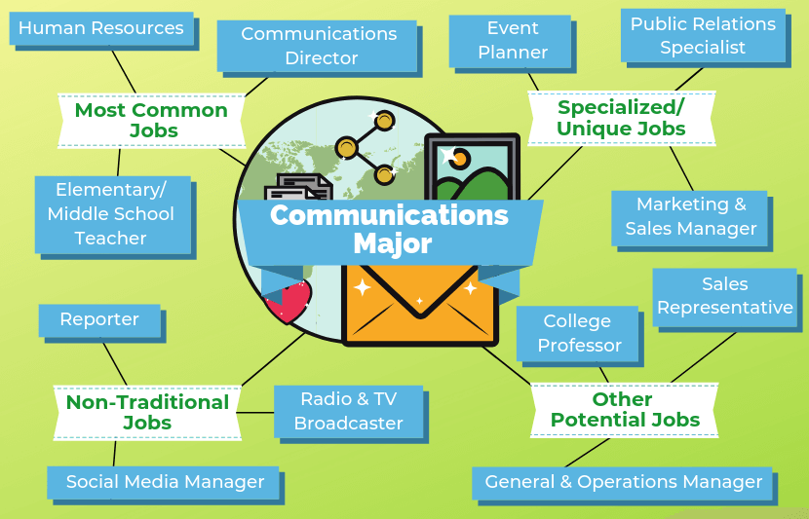
Requirement 9
Find out about three career opportunities in communication. Pick one and find out the education, training, and experience required for this profession. Discuss this with your counselor, and explain why this profession might interest you.

Slide 69
Career Opportunities in Communications
Advertising
Careers in advertising encompass many creative and technical professions that collectively work to increase brand awareness, customer retention and engagement.
Advertising focuses on creating and executing effective advertisements and campaigns in addition to other marketing-related initiatives that help companies meet their business objectives.
If you're interested in pursuing a fast-paced, highly collaborative and creative job, a career in advertising may be for you.
Most advertising jobs require you to have at least a bachelor's degree in a field like advertising, marketing, public relations, graphic design, communications, visual arts or another similar field.
Here are some careers you can pursue in advertising:
Social media coordinator.
Event planner.
Graphic designer.
Web designer.
Marketing coordinator.
Market researcher.
Copywriter.
Account executive.

Slide 70
Career Opportunities in Communications
Communication Education
To teach, you will need a minimum of a bachelor’s degree related to the subject you will be teaching.
Most communication educators teach courses at 4-year colleges.
These courses include public relations, radio/television broadcasting, and journalism.
Includes both educators primarily engaged in teaching and those who do a combination of teaching and research.
Some communication educators also work at elementary and secondary schools.
These careers include language arts teachers, speech teacher, debate coach, drama director.

Slide 71
Career Opportunities in Communications
Electronic Media, Radio, and Television Broadcasting
Network newscaster, talk-show hosts, and radio personalities are the glamorous positions in this field.
However, radio and television offer far more off-camera and off-microphone positions than on-air ones.
Some examples include broadcast station manager, video/audio librarian, community relations director, unit manager, video/audio editor, news director, news writer, technical director, media buyer, market researcher, producer, casting director, and researcher.

Slide 72
Career Opportunities in Communications
Journalism
Journalism involves researching and gathering information and communicating it to the public through written, spoken, visual, or electronic means.
Careers in journalism include reporter, editor, photographer, newscaster, author, scriptwriter, publisher, news service researcher, and technical writer.

Slide 73
Career Opportunities in Communications
Converging Media
Today, print and broadcast are converging (coming together).
Video/audio editing and production positions are now common at traditional print media companies. Today’s newspaper reporters are almost as likely to carry a small video camera as a notebook and pen.
Likewise, there are print-related positions at broadcast media companies. Reporters may write news updates for a broadcaster’s website. Web editors and producers are in demand at all kinds of media companies.
Completely new media are forming. One such example is the professionally produced blog, which may have millions of viewers. Often people with good training in journalism and communication operate these sites.

Slide 74
Career Opportunities in Communications
Web-Related Careers
Some of the newest positions in the digital age are webmaster (the person who creates or maintains a company’s website), web developer, web designer, information architect, web producer, graphic designer, programmer, multimedia specialist, systems administrator, and e-commerce specialist (someone who maintains the systems that process payments made online).
Other positions involve developing, monitoring, and managing websites.

Slide 75
Career Opportunities in Communications
Public Relations
This field usually involves managing the public image of an organization or an individual.
Careers in public relations include publicity manager, advertising manager, marketing specialist, press agent, lobbyist, corporate public affairs specialist, account executive, development officer, fund raiser, membership recruiter, sales manager, media analyst, media planner, creative director, audience analyst, news writer, and public opinion researcher.

Slide 76
Career Opportunities in Communications
Theater/Performing Arts/Dramatic Arts
Stars do exist in this glitzy industry, but successful performing careers are few and far between.
The majority of actors/performers do not reach star status. Rather, many take advantage of theatrical opportunities found in professional, community, and educational theaters across the country.

